Slide 1
Nonlinear Component Analysis as a Kernel Eigenvalue Problem
Jifu Zhao
Huan Yan
Vikram Idiga
Pavan Kumar Nadiminti
Nov. 16, 2016, Urbana

Slide 2
Content
Introduction
PCA
Kernel PCA
Algorithms
Examples
Summary & Extension

Slide 3

PCA
Invented by Karl Pearson, 1901*.
Main idea
Convert a set of correlated variables linearly uncorrelated variables through orthogonal transformation
Widely used for dimensionality reduction, feature extraction and data visualization
* https://en.wikipedia.org/wiki/Principal_component_analysis

Slide 4
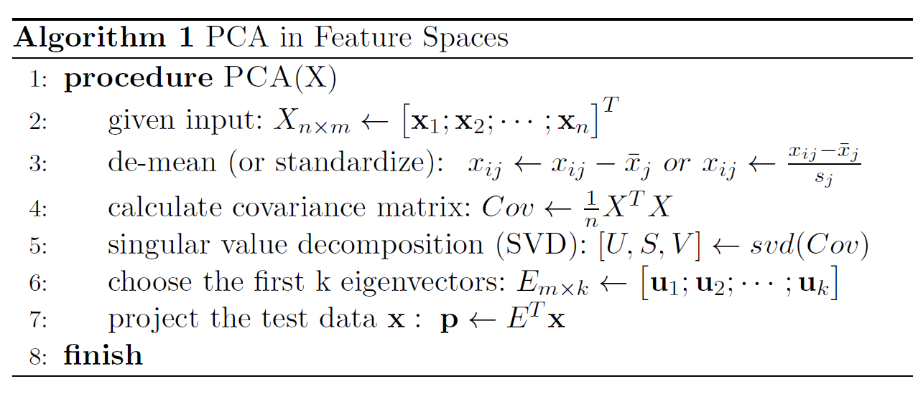
PCA
Invented by Karl Pearson, 1901*.
Main idea
Convert a set of correlated variables linearly uncorrelated variables through orthogonal transformation
Widely used for dimensionality reduction, feature extraction and data visualization
* https://en.wikipedia.org/wiki/Principal_component_analysis

Slide 5
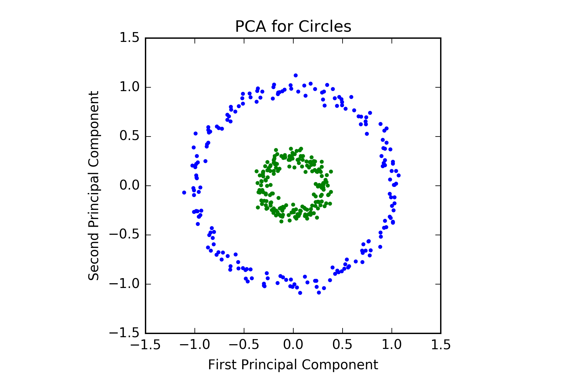
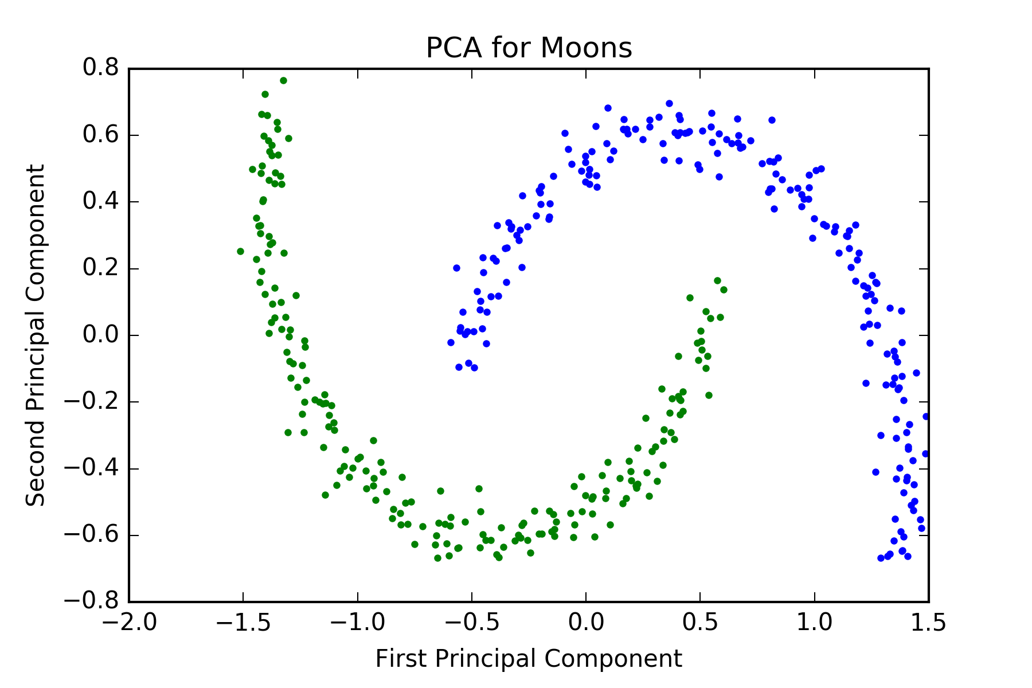
Why Kernel PCA ?
PCA works well in a lot of applications
However, in this simple case, PCA doesn’t work at all
We need some nonlinear transformations

Slide 6
Kernel PCA
Put forward by Scholkopf et al., 1998*
Main idea
Expand the original feature space by non-linear transformations
Apply PCA in the transformed feature space
Main drawback
Expanded feature space may have very high dimensions
Apply PCA is computationally expensive or even impossible
Solution -- Kernels
* Friedman, J., Hastie, T., & Tibshirani, R. The elements of statistical learning.

Slide 7
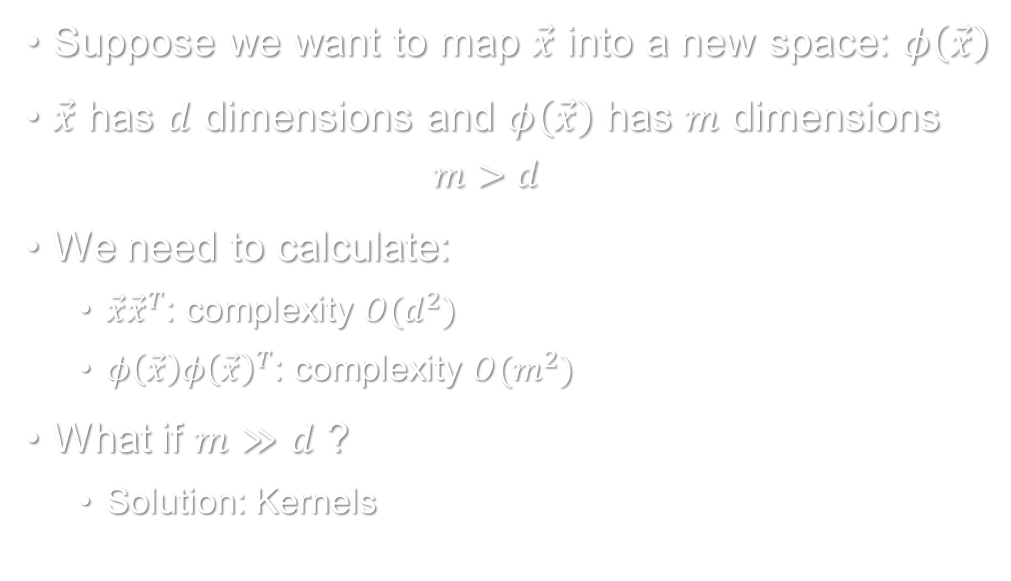
Expand the feature space
Suppose we want to map $\vec{x}$ into a new space: $φ\left(\vec{x}\right)$
$\vec{x}$ has $d$ dimensions and $φ\left(\vec{x}\right)$ has $m$ dimensions
$$m>d$$
We need to calculate:
$\vec{x}{\vec{x}}^{T}$: complexity $O(d^{2})$
$φ\left(\vec{x}\right){φ\left(\vec{x}\right)}^{T}$: complexity $O(m^{2})$
What if $m≫d$ ?
Solution: Kernels

Slide 8
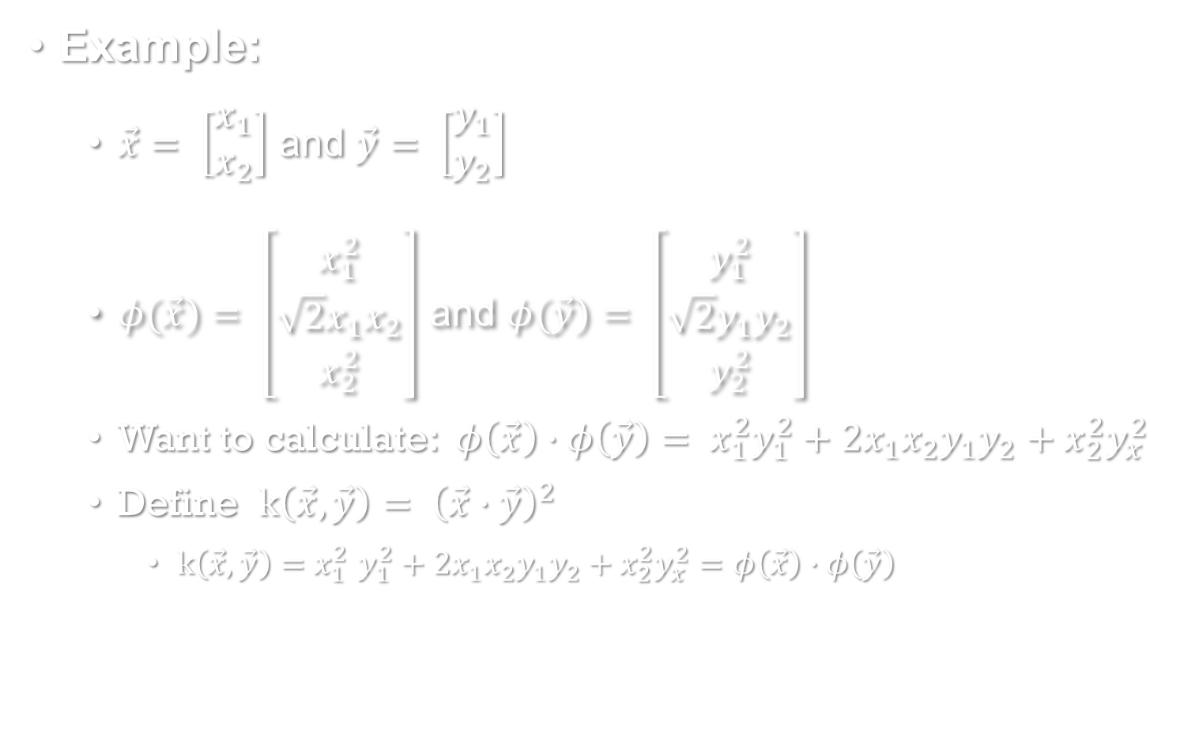
“Kernel Trick”(1)
Example:
$\vec{x}= \left[\begin{matrix}x_{1} \\ x_{2}\end{matrix}\right]$ and $\vec{y}= \left[\begin{matrix}y_{1} \\ y_{2}\end{matrix}\right]$
$φ(\vec{x})= \left[\begin{matrix}x_{1}^{2} \\ \sqrt{2}x_{1}x_{2} \\ x_{2}^{2}\end{matrix}\right]$ and $φ(\vec{y})= \left[\begin{matrix}y_{1}^{2} \\ \sqrt{2}y_{1}y_{2} \\ y_{2}^{2}\end{matrix}\right]$
Want to calculate: $φ\left(\vec{x}\right)∙φ\left(\vec{y}\right)= x_{1}^{2}y_{1}^{2}+2x_{1}x_{2}y_{1}y_{2}+x_{2}^{2}y_{x}^{2}$
Define $k\left(\vec{x}, \vec{y}\right){= \left(\vec{x}∙\vec{y}\right)}^{2}$
$k\left(\vec{x}, \vec{y}\right){=x}_{1}^{2}y_{1}^{2}+2x_{1}x_{2}y_{1}y_{2}+x_{2}^{2}y_{x}^{2}=φ\left(\vec{x}\right)∙φ\left(\vec{y}\right)$

Slide 9
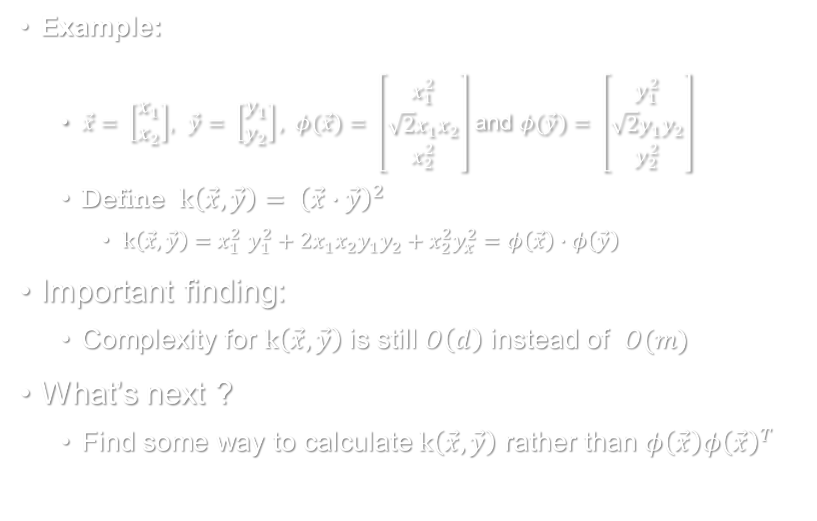
“Kernel Trick”(1)
Example:
$\vec{x}= \left[\begin{matrix}x_{1} \\ x_{2}\end{matrix}\right]$, $\vec{y}= \left[\begin{matrix}y_{1} \\ y_{2}\end{matrix}\right], φ(\vec{x})= \left[\begin{matrix}x_{1}^{2} \\ \sqrt{2}x_{1}x_{2} \\ x_{2}^{2}\end{matrix}\right]$ and $φ(\vec{y})= \left[\begin{matrix}y_{1}^{2} \\ \sqrt{2}y_{1}y_{2} \\ y_{2}^{2}\end{matrix}\right]$
Define $k\left(\vec{x}, \vec{y}\right){= \left(\vec{x}∙\vec{y}\right)}^{2}$
$k\left(\vec{x}, \vec{y}\right){=x}_{1}^{2}y_{1}^{2}+2x_{1}x_{2}y_{1}y_{2}+x_{2}^{2}y_{x}^{2}=φ\left(\vec{x}\right)∙φ\left(\vec{y}\right)$
Important finding:
Complexity for $k\left(\vec{x}, \vec{y}\right)$ is still $O\left(d\right)$ instead of $O(m)$
What’s next ?
Find some way to calculate $k\left(\vec{x}, \vec{y}\right)$ rather than $φ\left(\vec{x}\right){φ\left(\vec{x}\right)}^{T}$

Slide 10
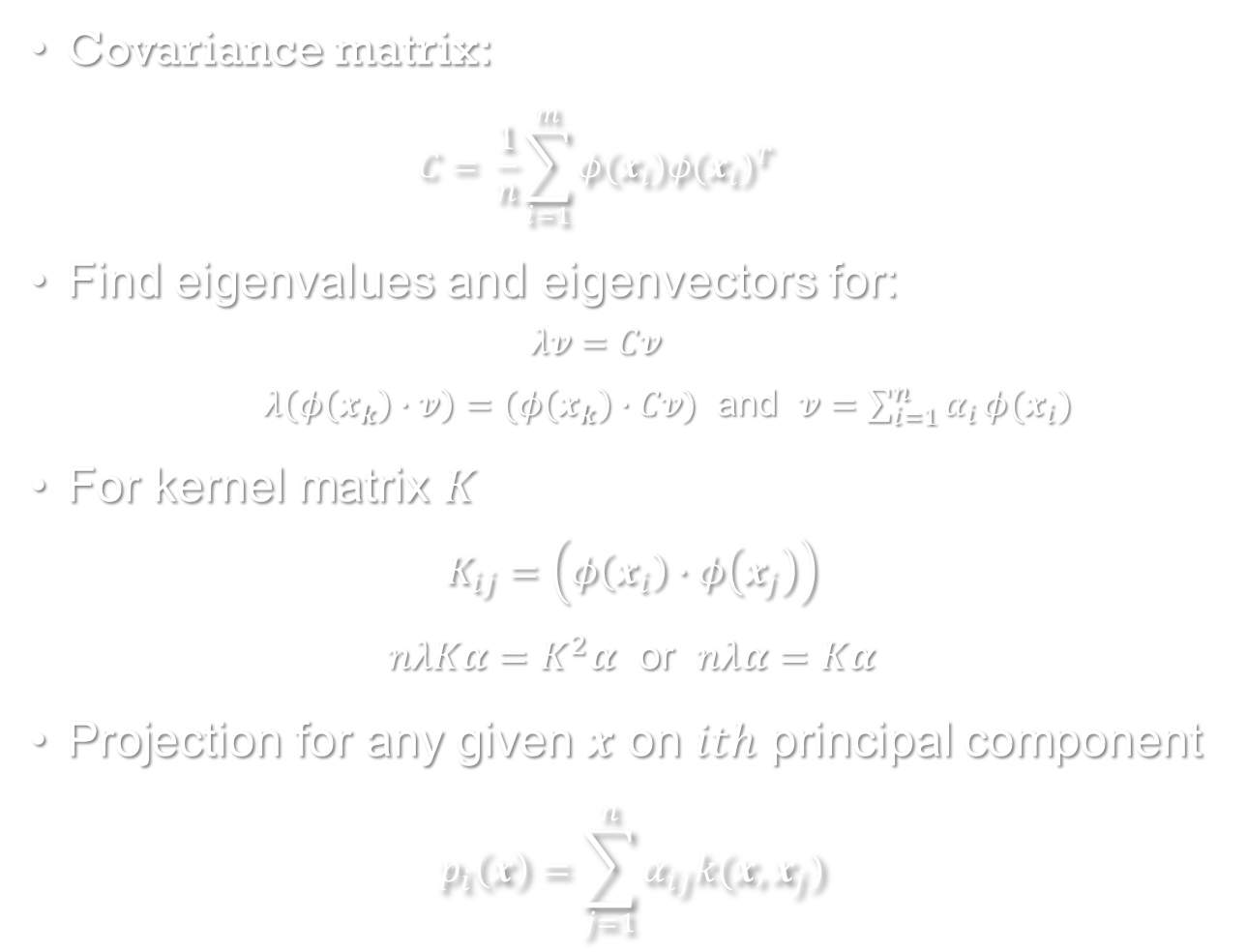
“Kernel Trick”(2)
Covariance matrix:
$$C= \frac{1}{n}\sum_{i=1}^{m}{φ(x_{i}){φ(x_{i})}^{T}}$$
Find eigenvalues and eigenvectors for:
$$λv=Cv$$
$λ\left(φ\left(x_{k}\right)∙v\right)=(φ\left(x_{k}\right)∙Cv)$ and $v=\sum_{i=1}^{n}{α_{i}}φ(x_{i})$
For kernel matrix $K$
$$K_{ij}=\left(φ\left(x_{i}\right)∙φ\left(x_{j}\right)\right)$$
$nλKα=K^{2}α$ or $nλα=Kα$
Projection for any given $x$ on $ith$ principal component
$$p_{i}\left(x\right)=\sum_{j=1}^{n}{α_{ij}k(x, x_{j})}$$

Slide 11

Kernel PCA Algorithm
Conclusion:
Only need to calculate the kernel matrix $K$
find the eigenvalues and eigenvectors for $K$
* Bishop, C. M. Pattern Recognition and Machine Learning.

Slide 12
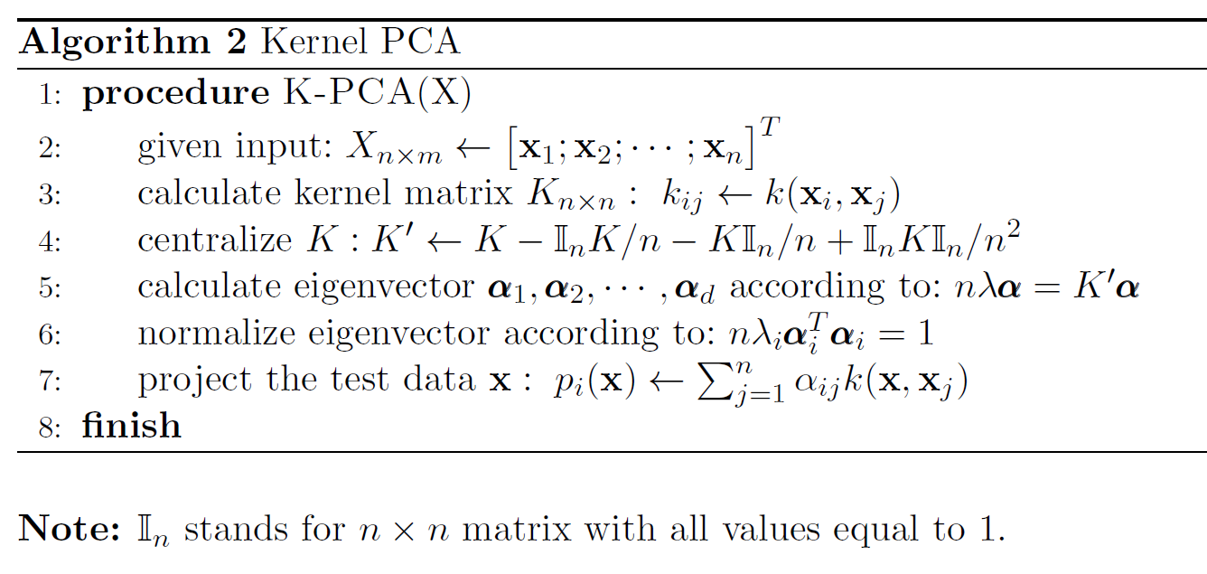
Kernel PCA Algorithm
Conclusion:
Only need to calculate the kernel matrix $K$
find the eigenvalues and eigenvectors for $K$
* Bishop, C. M. Pattern Recognition and Machine Learning.

Slide 13
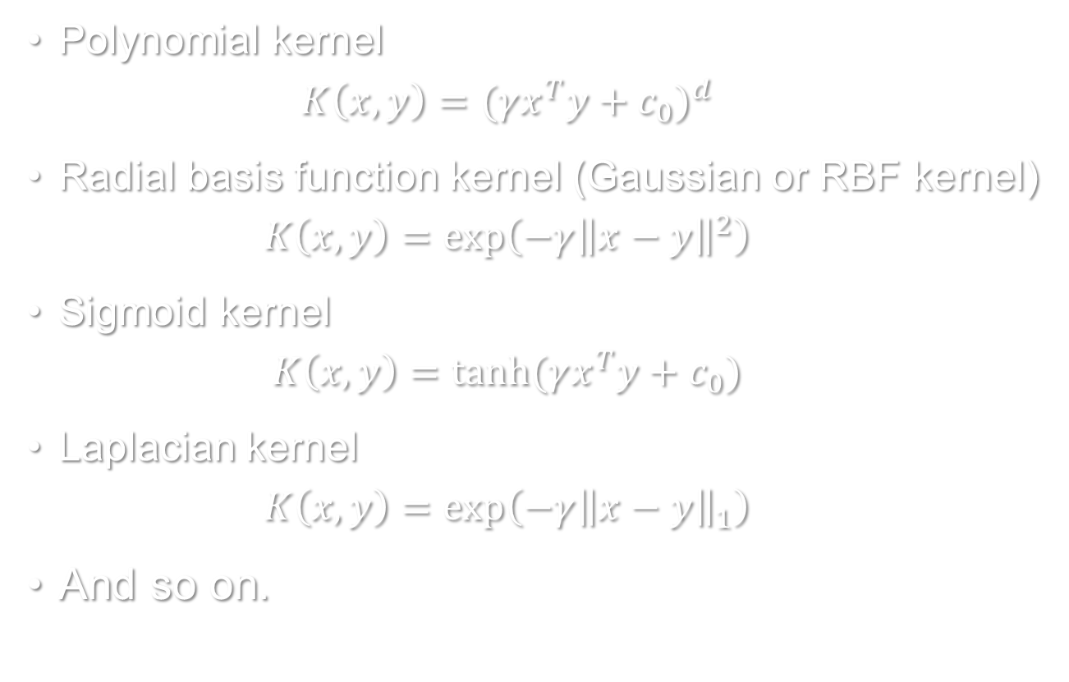
Commonly Used Kernels*
Polynomial kernel
$$K\left(x, y\right)={(γx^{T}y+c_{0})}^{d}$$
Radial basis function kernel (Gaussian or RBF kernel)
$$K\left(x, y\right)=\exp\left(−γ{\left\|x−y\right\|}^{2}\right)$$
Sigmoid kernel
$$K\left(x, y\right)=tanh⁡(γx^{T}y+c_{0})$$
Laplacian kernel
$$K\left(x, y\right)=\exp\left(−γ{\left\|x−y\right\|}_{1}\right)$$
And so on.
* http://scikit-learn.org/stable/modules/metrics.html#metrics

Slide 14
Toy Examples

Slide 15
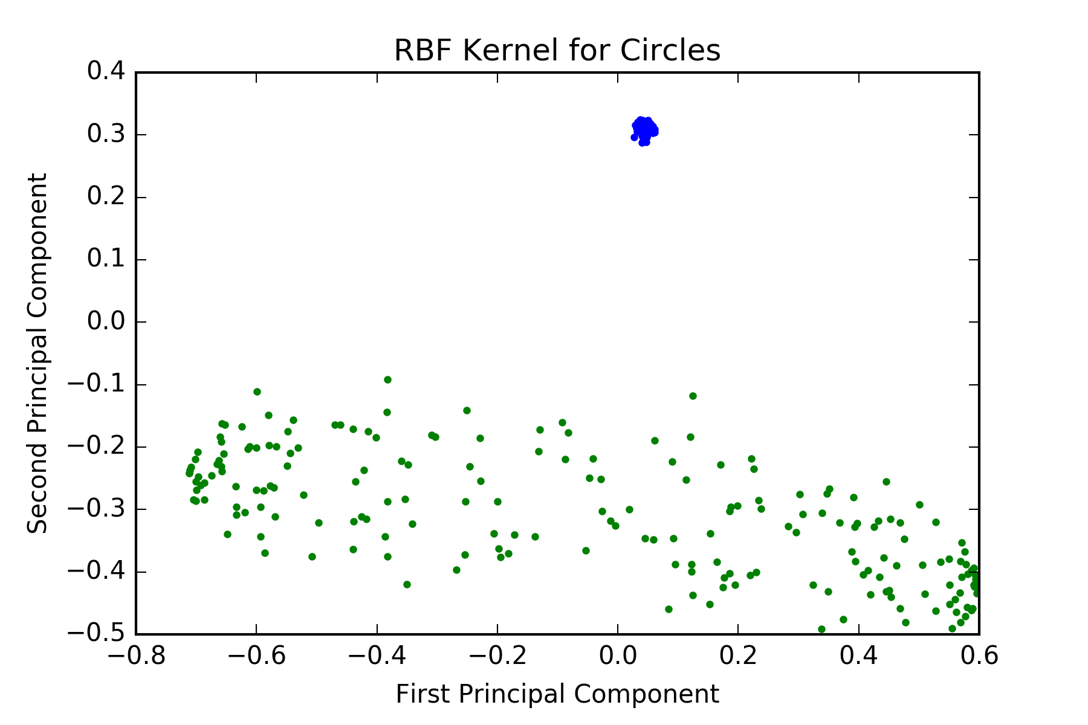
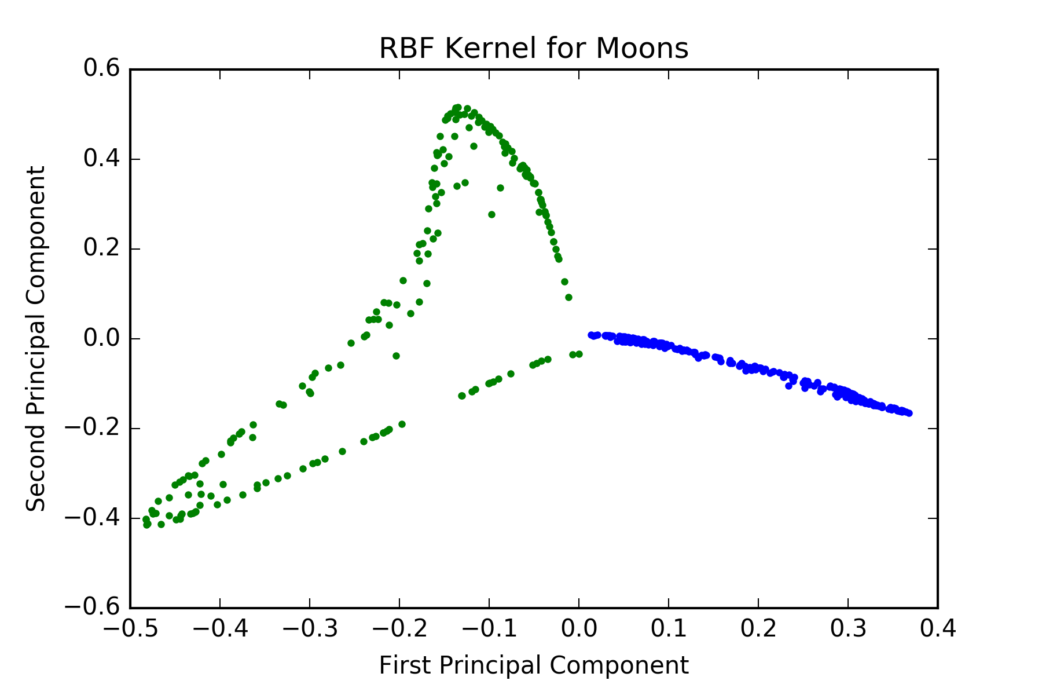
Toy Examples

Slide 16
Iris Dataset – Introduction
Iris flower dataset is introduced by Ronald Fisher (1936)*
It contains 3 different types of irises (Setosa, Versicolor, and Virginica)**.
The dataset has 150 records and each has 4 features:
Sepal Length
Sepal Width
Petal Length
Petal Width.
* https://en.wikipedia.org/wiki/Iris_flower_data_set
** http://scikit-learn.org/stable/auto_examples/datasets/plot_iris_dataset.html

Slide 17
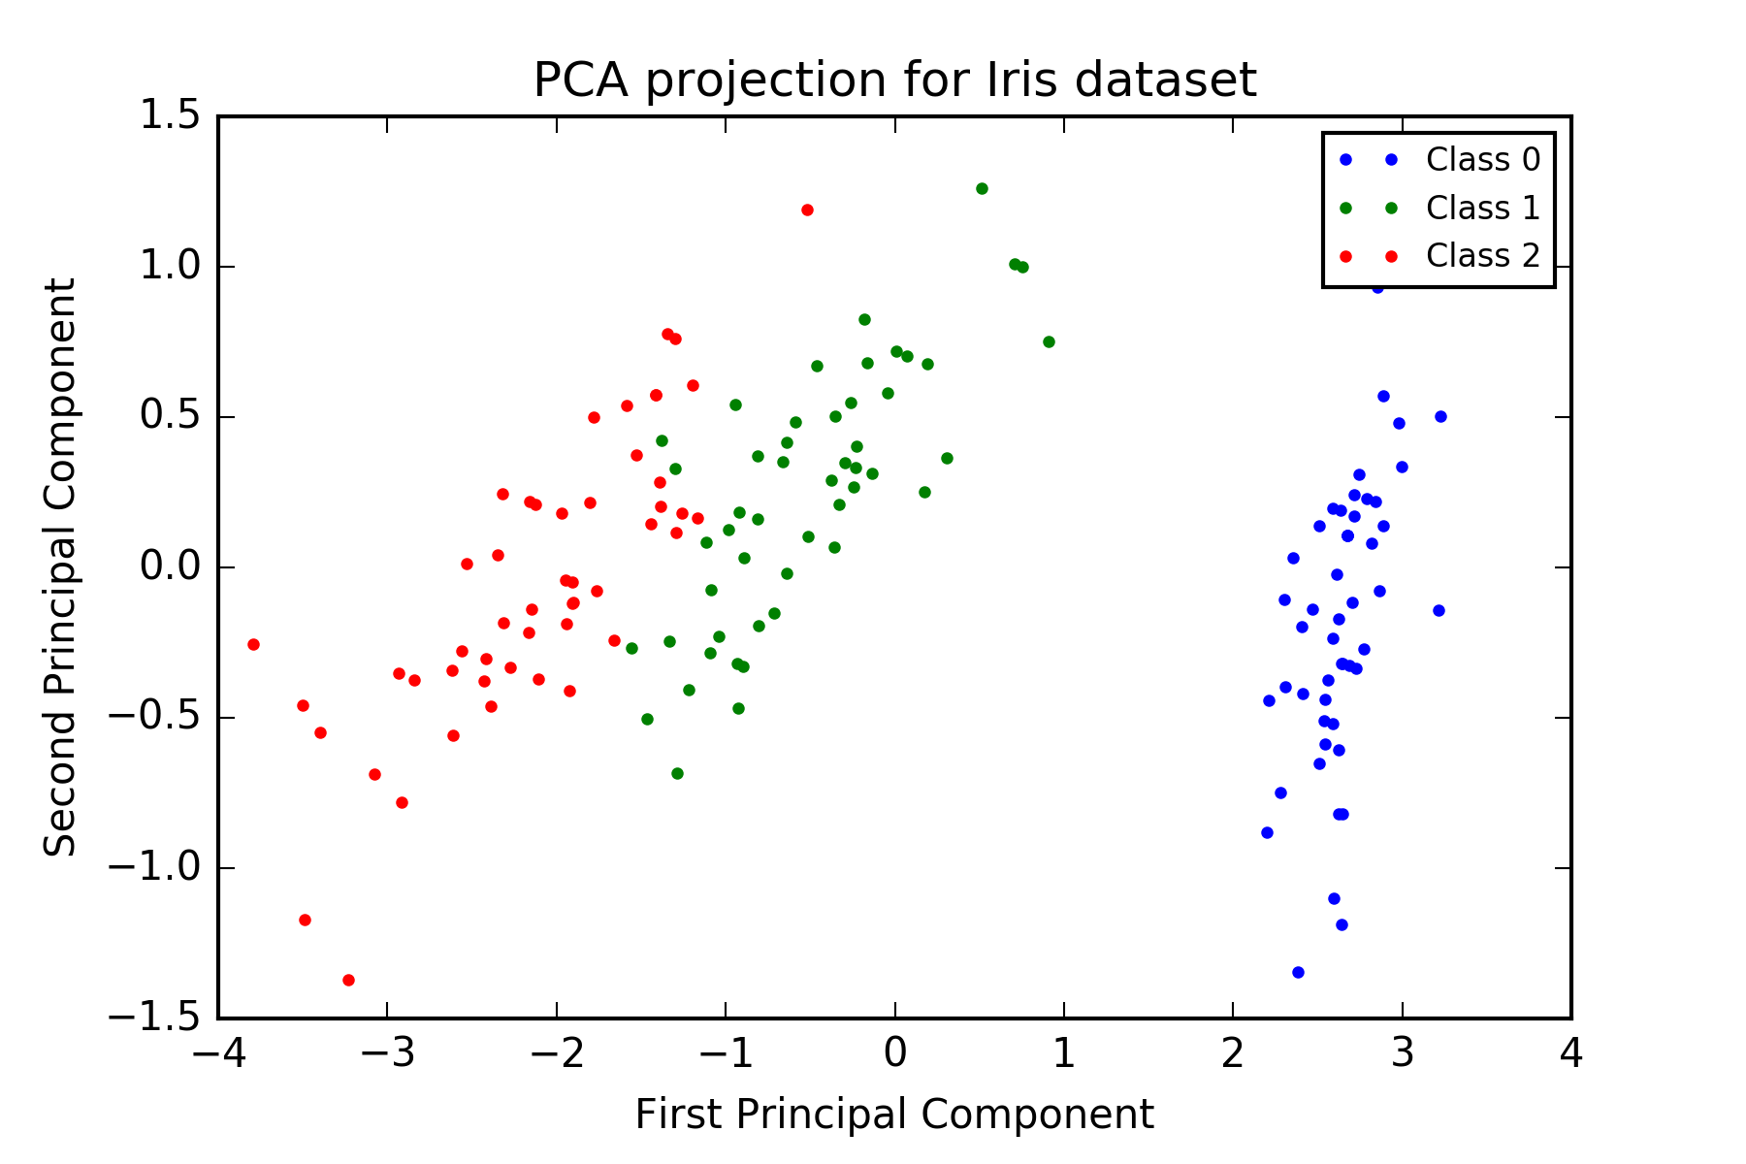
Iris Dataset – PCA vs. K-PCA

Slide 18
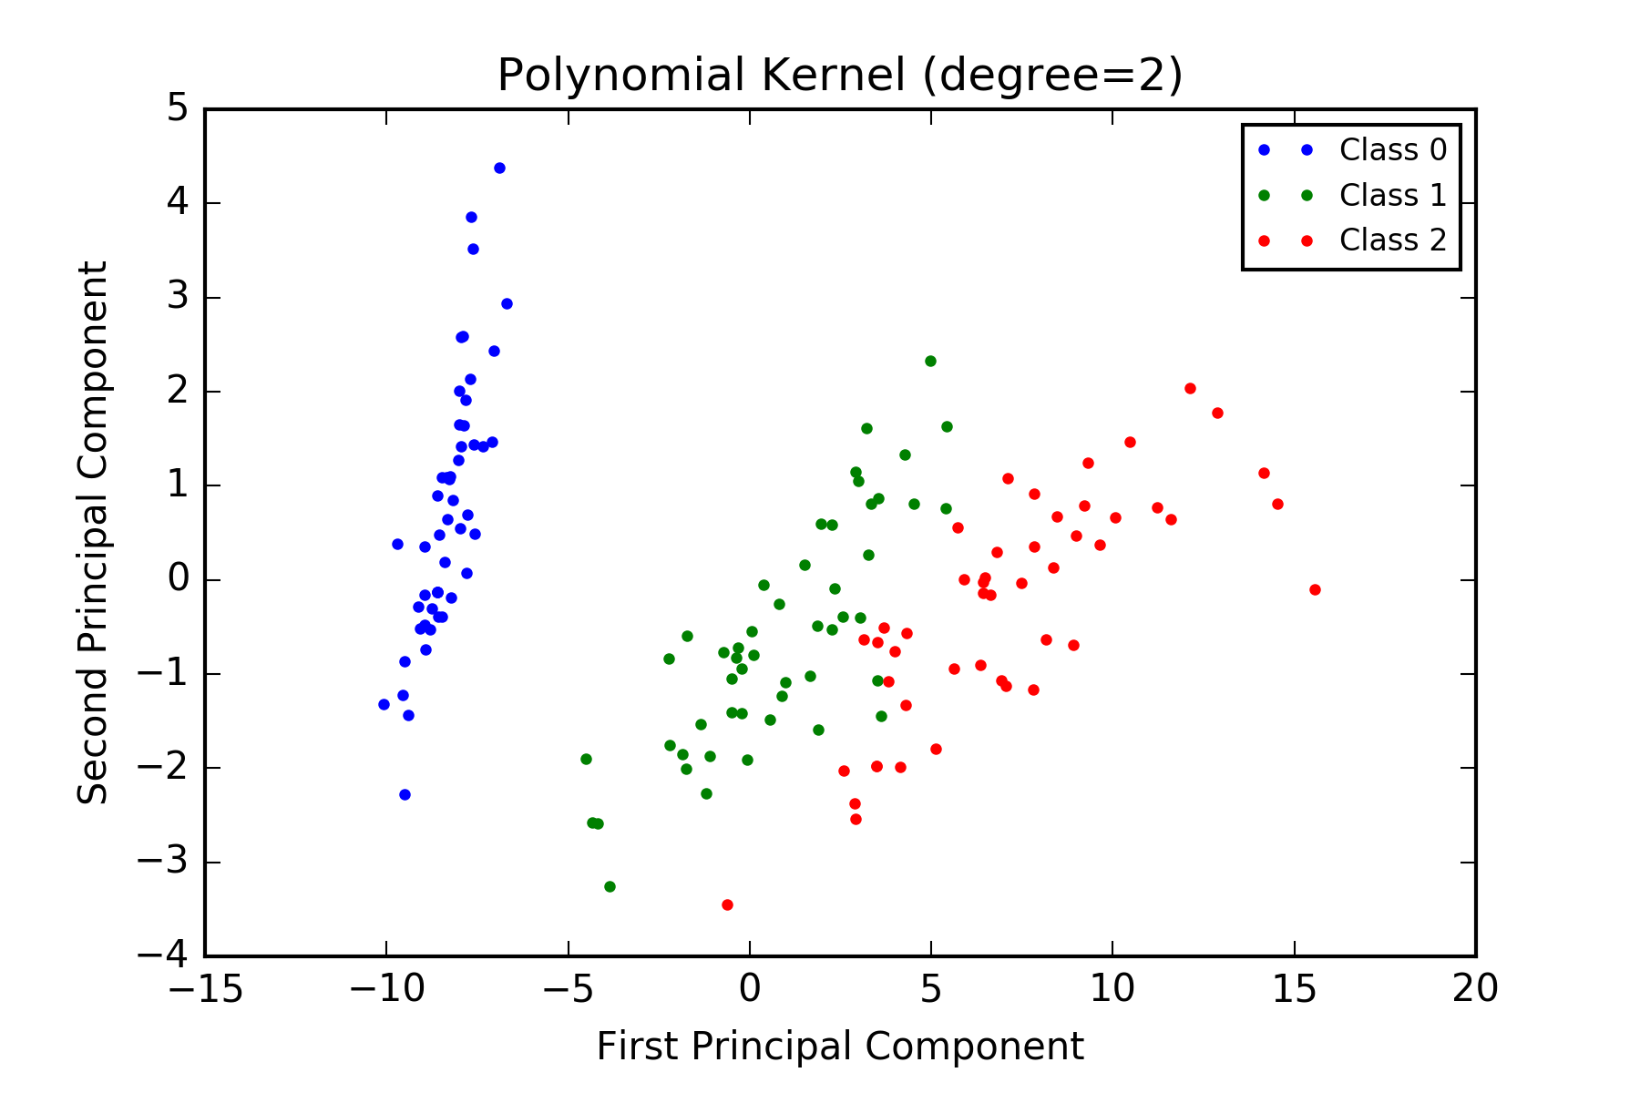
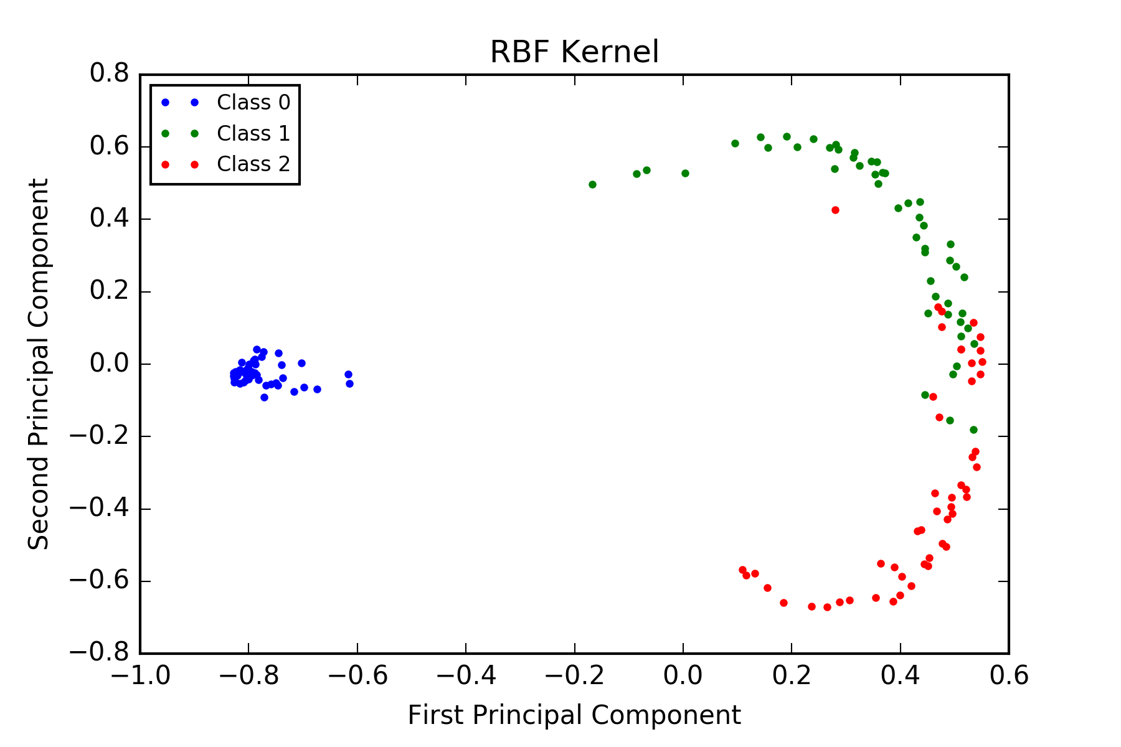
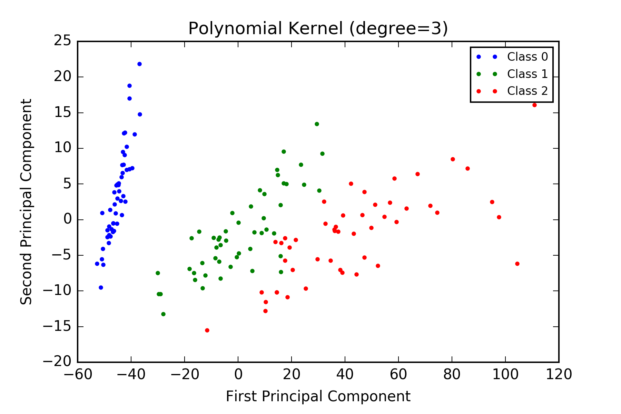
Iris Dataset – PCA vs. K-PCA

Slide 19
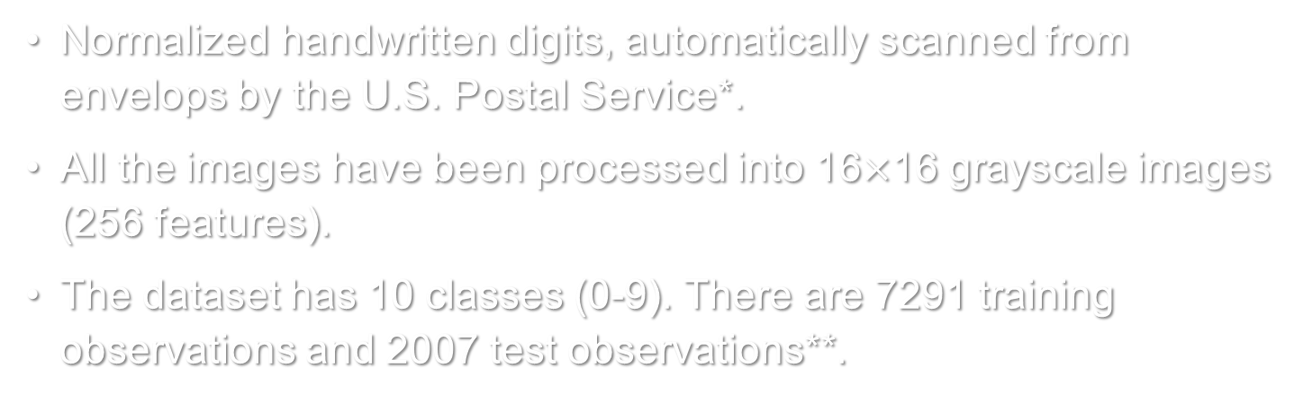
Digits Dataset – Introduction
Normalized handwritten digits, automatically scanned from envelops by the U.S. Postal Service*.
All the images have been processed into 16$×$16 grayscale images (256 features).
The dataset has 10 classes (0-9). There are 7291 training observations and 2007 test observations**.
Class | 0 | 1 | 2 | 3 | 4 | 5 | 6 | 7 | 8 | 9 | Total
Train | 1194 | 1005 | 731 | 658 | 652 | 556 | 664 | 645 | 542 | 644 | 7291
Test | 359 | 264 | 198 | 166 | 200 | 160 | 170 | 147 | 166 | 177 | 2007
* http://statweb.stanford.edu/~tibs/ElemStatLearn/datasets/zip.info.txt
** https://www.otexts.org/1577

Slide 20
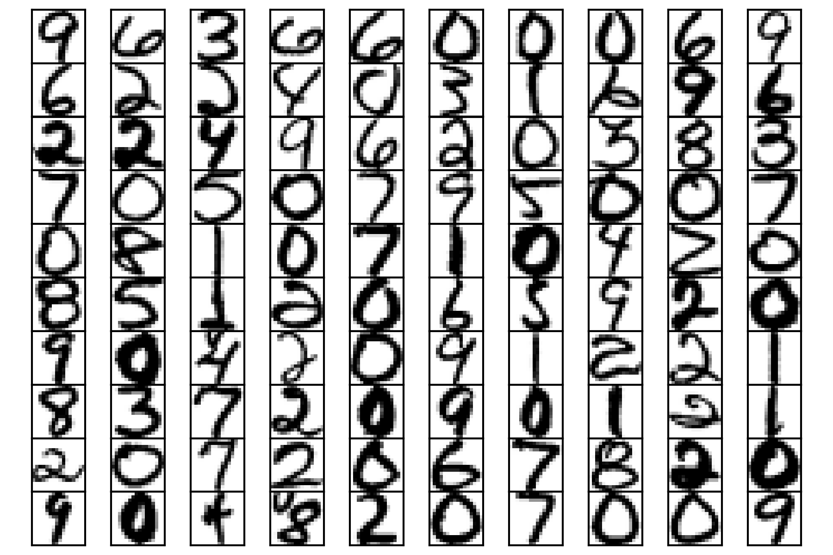
Digits Dataset – Introduction

Slide 21
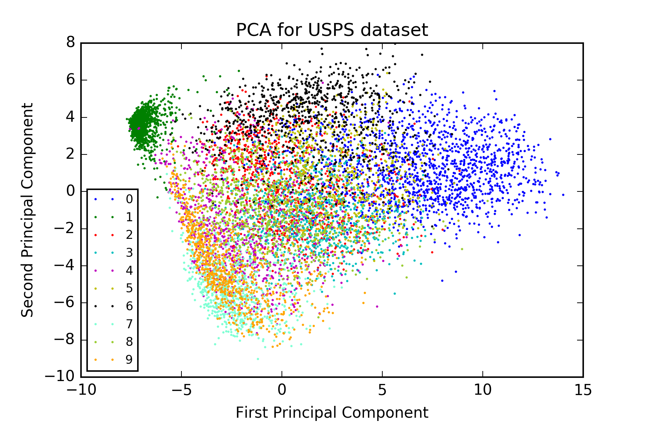
Digits Dataset – PCA vs. K-PCA

Slide 22
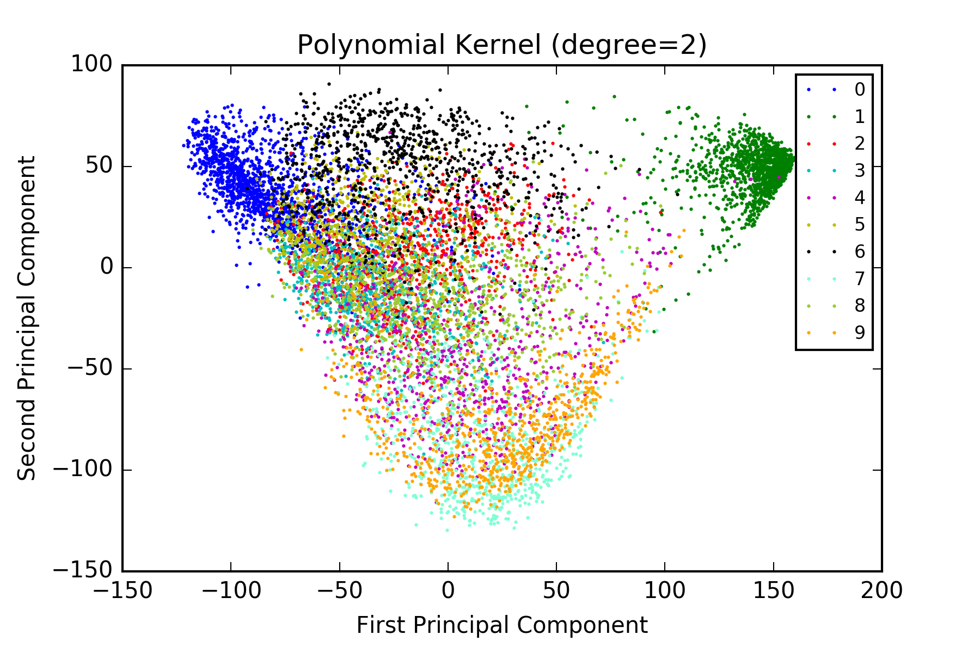
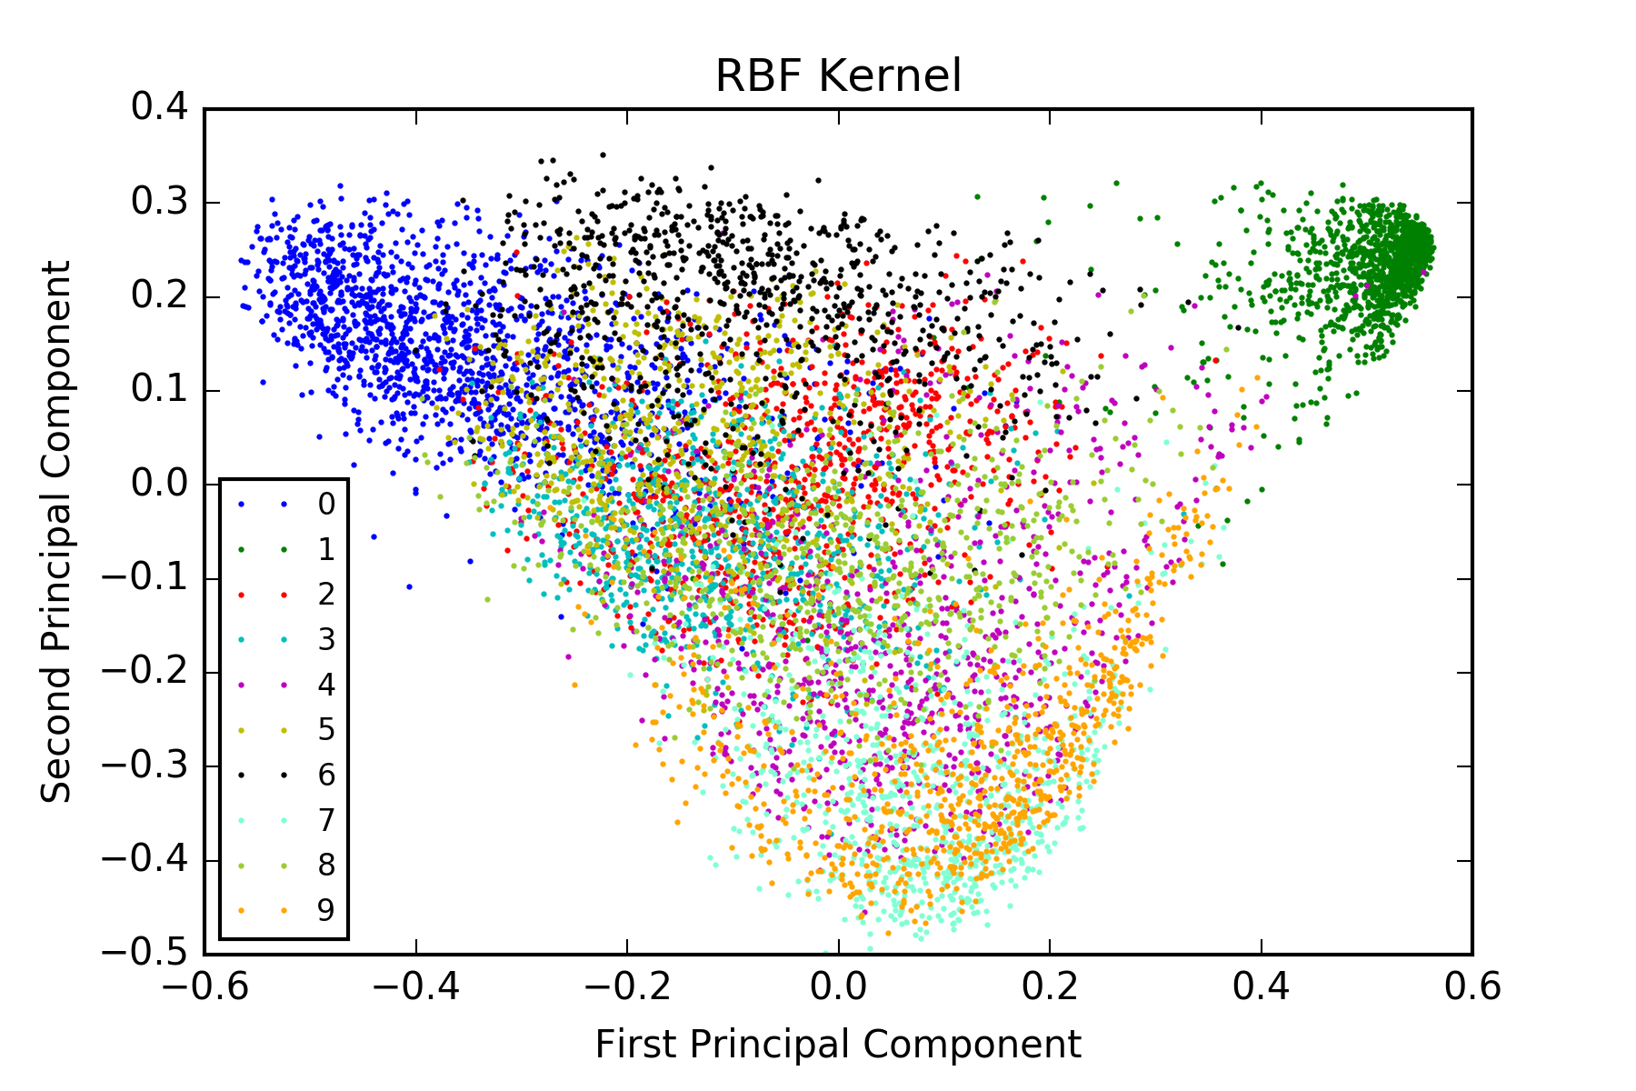
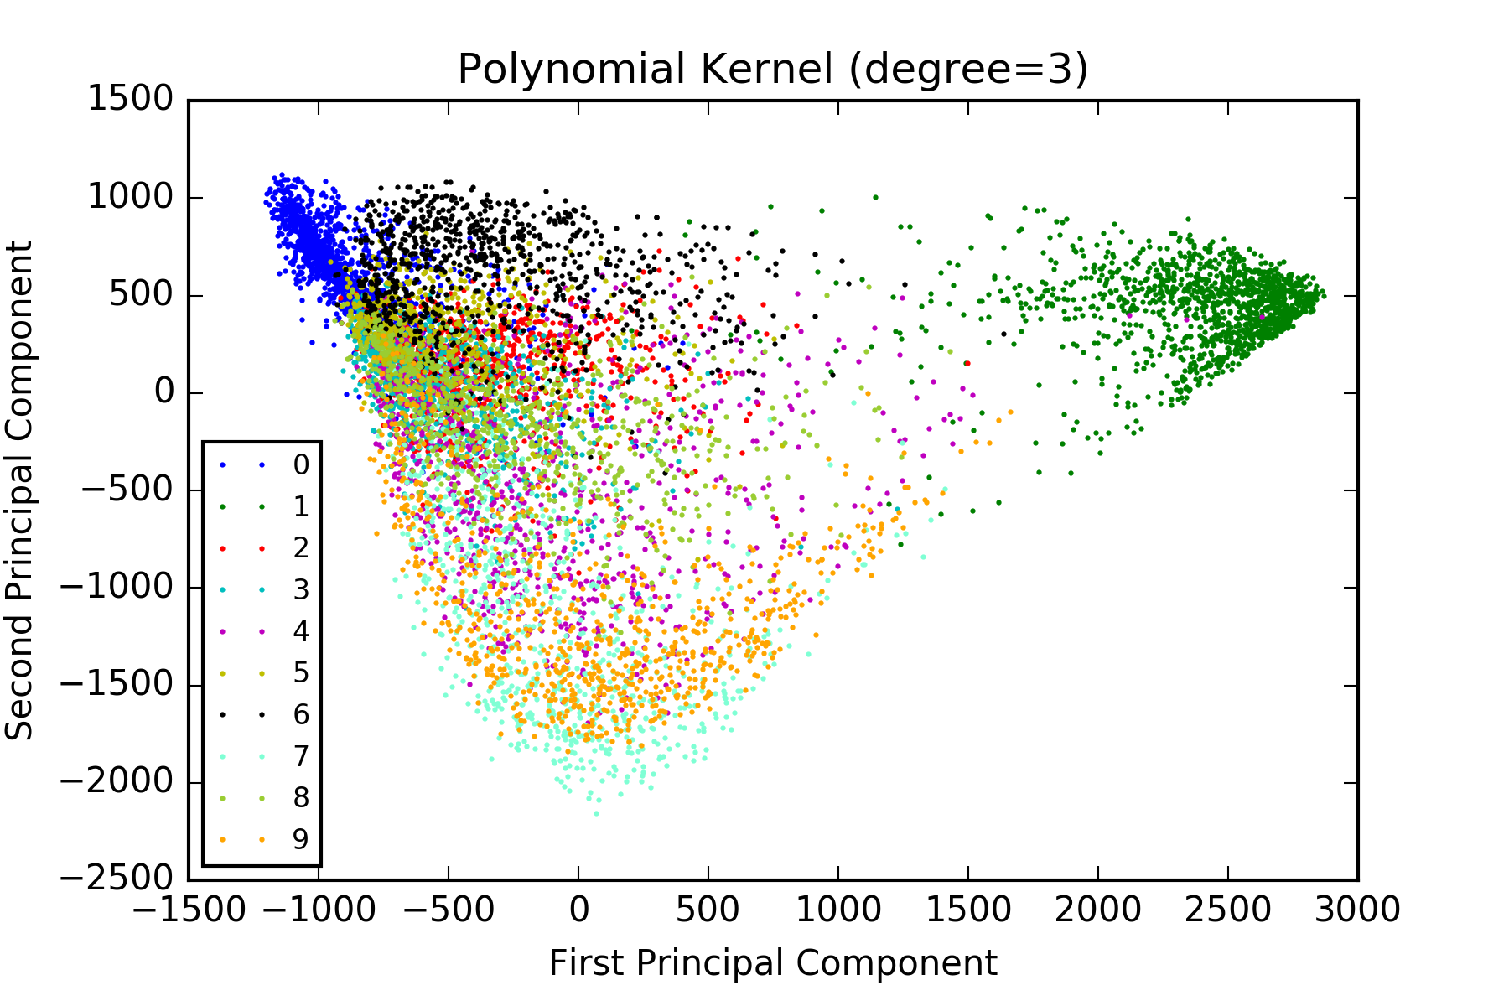
Digits Dataset – PCA vs. K-PCA

Slide 23
Digits Dataset – Classification
Train a 10-way multi-class neural network for classification
0
1
………
9
X1
X2
…………
Xp
+1

Slide 24
Digits Dataset – Classification
Train a 10-way multi-class neural network for classification
Training accuracy and testing accuracy
0
1
………
9
X1
X2
…………
Xp
+1
Inputs | Raw image | PCA | Polynomial Kernel (degree=2) | Polynomial Kernel (degree=3) | RBF Kernel
Feature Number | 256 | 128 | 512 | 1024 | 1024
Training Accuracy | 95.52% | 94.94% | 99.99% | 98.51% | 93.58%
Test Accuracy | 90.98% | 90.23% | 94.42% | 93.92% | 88.14%

Slide 25
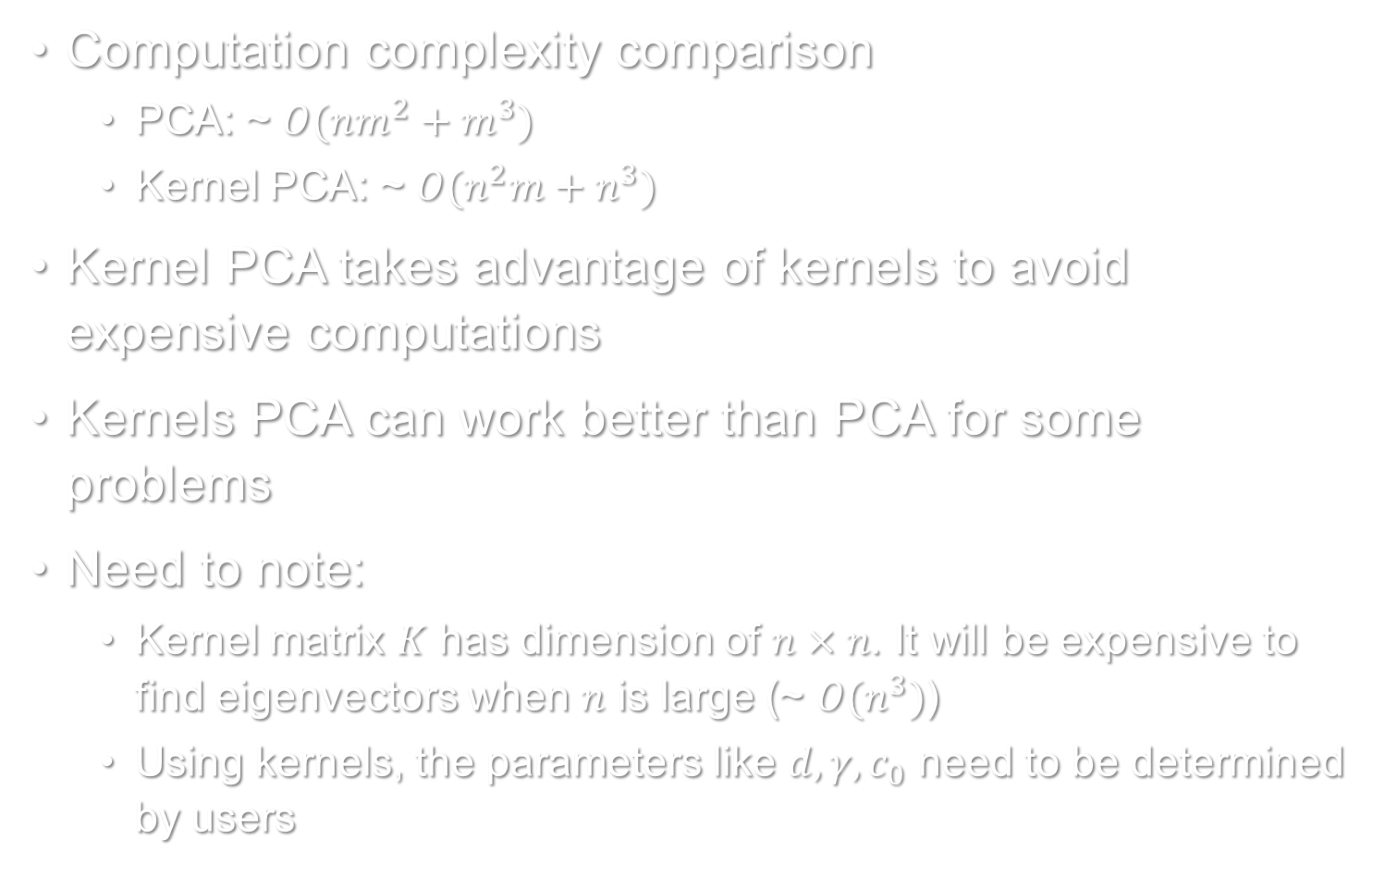
Summary
Computation complexity comparison
PCA: ~ $O(nm^{2}+m^{3})$
Kernel PCA: ~ $O(n^{2}m+n^{3})$
Kernel PCA takes advantage of kernels to avoid expensive computations
Kernels PCA can work better than PCA for some problems
Need to note:
Kernel matrix $K$ has dimension of $n×n$. It will be expensive to find eigenvectors when $n$ is large (~ $O(n^{3})$)
Using kernels, the parameters like $d, γ, c_{0}$ need to be determined by users

Slide 26
Extension
Dimensionality reduction is more generally used
There are a lot of methods for dimensionality reduction
Independent Component Analysis (ICA)
Non-negative Matrix Factorization (NMF)
Isometric Feature Mapping (ISOMAP)
Locality Sensitive Hashing (LSH)
Latent Semantic Analysis (LSA)
Restricted Boltzmann Machine (RBM)
Auto-encoder
And so on

Slide 27
Questions?
Language:
Python + TensorFlow
All source codes are available in GitHub
https://github.com/JifuZhao/UIUC_Courses/tree/master/UIUC_IE529/project/code
Thank you.

Slide 28
References
https://en.wikipedia.org/wiki/Principal_component_analysis
http://scikit-learn.org/stable/modules/metrics.html#metrics
https://en.wikipedia.org/wiki/Iris_flower_data_set
http://scikit-learn.org/stable/auto_examples/datasets/plot_iris_dataset.html
https://www.otexts.org/1577
http://statweb.stanford.edu/~tibs/ElemStatLearn/datasets/zip.info.txt
Schölkopf, B., Smola, A. & Müller, K.R., 1998. Nonlinear component analysis as a kernel eigenvalue problem. Neural computation.
Friedman, J., Hastie, T., & Tibshirani, R. The elements of statistical learning.
Bishop, C. M. Pattern Recognition and Machine Learning.

